Slide 1

DIABETES PREDICTION USING ML
EXPOSYS DATA LABS

Slide 2

About the Company
Exposys Data Labs is a Bengaluru based company which aims to Solve real world business problems like Automation, Big Data and data Science. Exposys Data labs also helps businesses to
identify prototype
and trending technologies like AI, ML, Deep Learning and Data Science.
issues,
opportunities
solutions
using

Slide 3

SERVICES OFFERED BY THE COMPANY
Software Development
Understand and develop the client's product idea and deliver a working software
Web App Development
Develops business- critical applications and development services
Internships
Partnered with several companies to provide a unique interning experience for students.

Slide 4

Problem
Statement
Given the dataset, create a Machine learning model
to
predict if a person has
diabetes

Slide 5




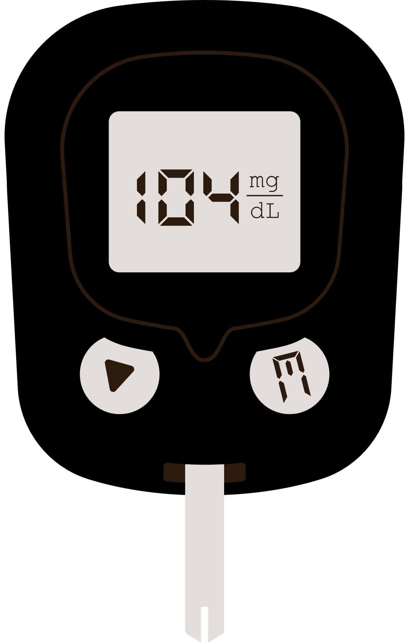
WORKFLOW OF THE MODEL
DIABETES DATASET
DATA PRE-PROCESSING
TRAIN TEST SPLIT
TRAINING USING DIFFERENT CLASSIFIERS
DIABETES TEST DATA
BEST CLASSIFIER
PREDICTION

Slide 6
DATASET
The dataset included details of 253000 people that were used to train and test the ML model. The features in this dataset were
GenHlth
Age
BMI
while the target variable was
Diabetes_binary

Slide 7

DATA PREPROCESSING
It is a data mining technique which is used to transform the raw data in a useful and efficient format. This includes
Data Cleaning
Missing Data Noisy Data
Data Transformation
Normalization Attribute Selection
Data Reduction
How this is in my project?
Checked for null values using isnull() function Checked for duplicate values using duplicated() function

Slide 8
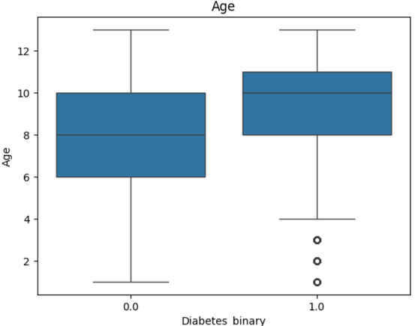
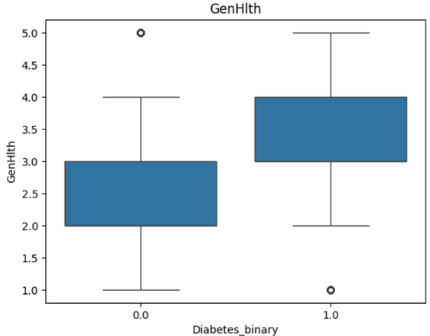

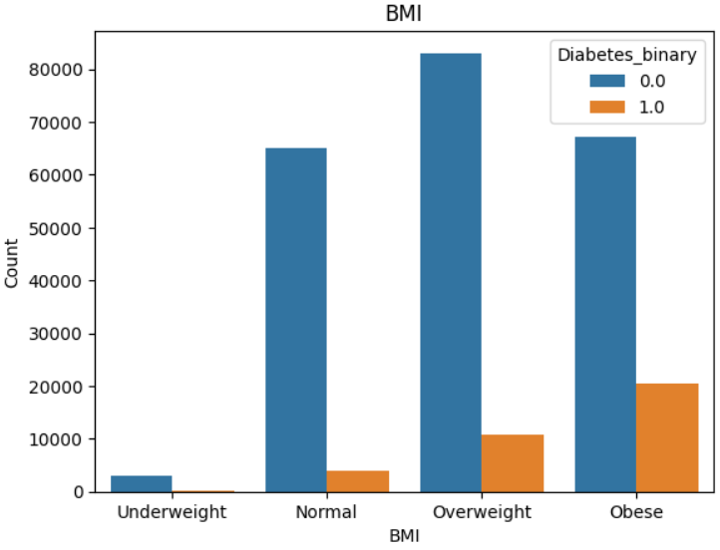


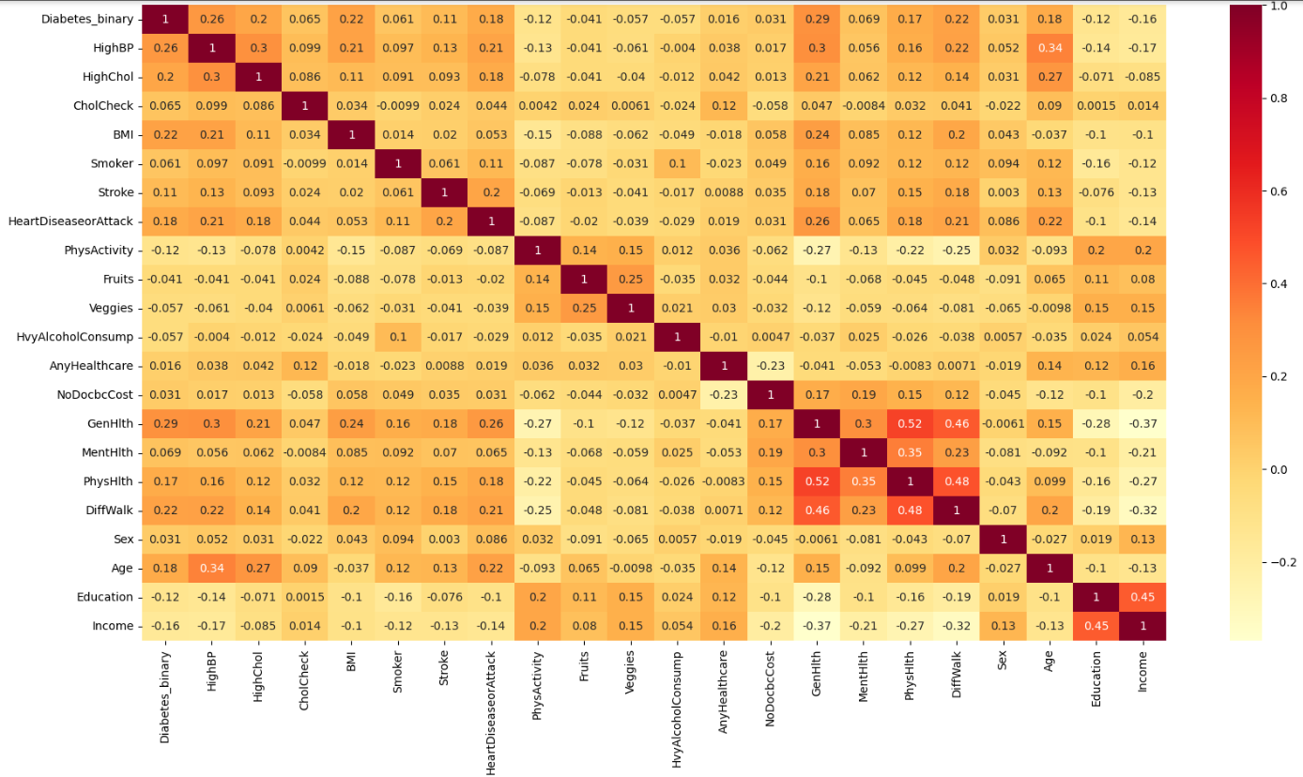
BOXPLOT
H I S T O G R A M
H E A T M A P

Slide 9

SPLITTING DATA INTO TRAIN AND TEST
Training data is the data you use to train an algorithm or machine learning model to predict the outcome you design your model to predict
Test data is used to measure the performance, such as accuracy or efficiency, of the algorithm you are using to train the machine.
The split percentage used in the project is 80 and 20 respectively for train and test data. We fit our model on the train data, in order to make predictions on the test data.

Slide 10
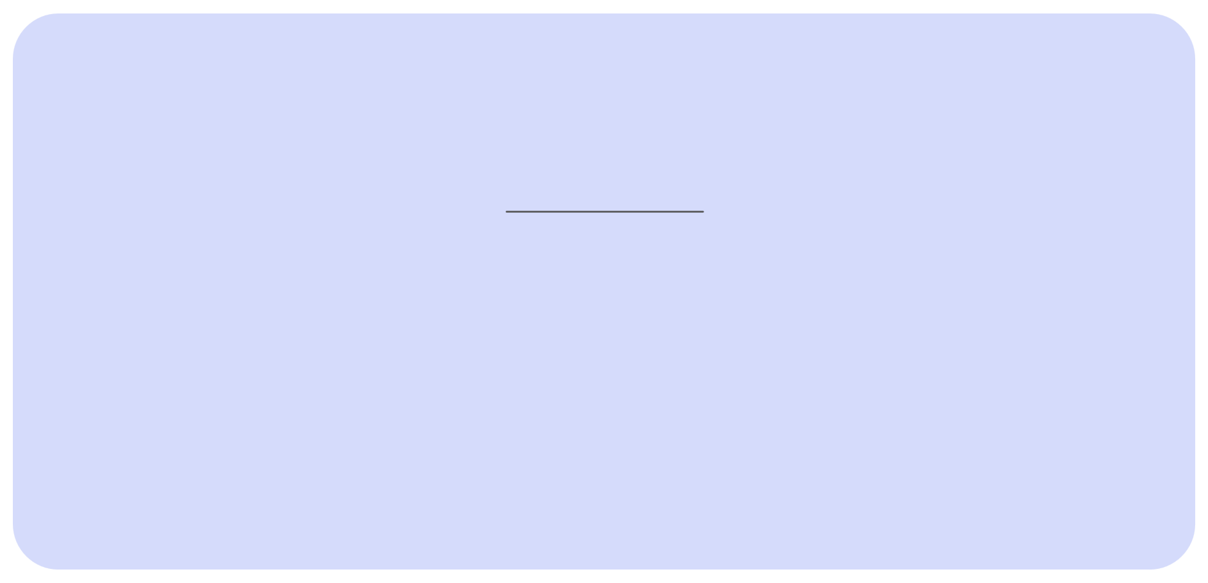
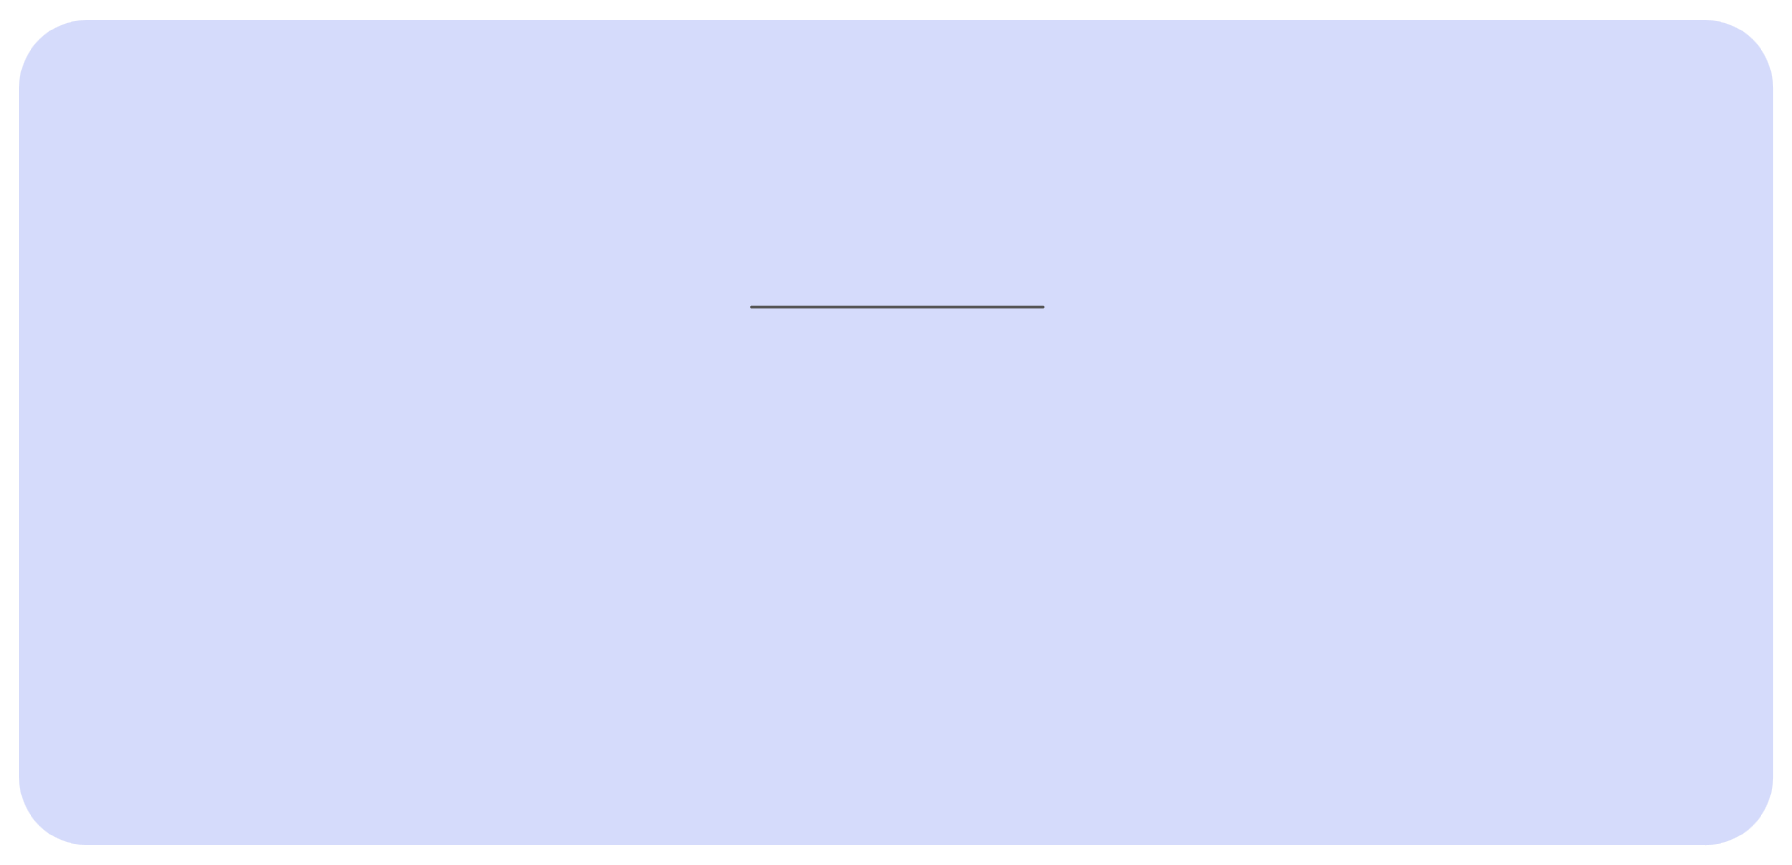


DIFFERENT CLASSIFIERS
Neural Networks
Gradient Boosting
It builds models sequentially, each one correcting the errors of its predecessor, to achieve high accuracy by combining the strengths of multiple weak learners.
It is inspired by the human brain, consisting of interconnected layers of nodes (neurons) that process data and learn to make predictions through iterative adjustments.
Support Vector Machines
Decision Tree Classifier
It breaks down a dataset into smaller and smaller subsets while at the same time an associated decision tree is incrementally developed.
It works by finding the hyperplane that best separates the data into distinct classes

Slide 11
DIFFERENT CLASSIFIERS
K Nearest Neighbors
Naive Bayes
Naive Bayes is a probabilistic classifier based on Bayes' theorem, assuming strong (naive) independence between features.
It is a simple, non-parametric classification algorithm that assigns a class to a data point based on the majority class of its k closest neighbors in the feature space
Logistic Regression
Random Forest Classifier
It constructs multiple decision trees during training and outputs the class that is the mode of the classes of the individual trees.
It models the probability of a binary outcome by fitting data to a logistic curve.

Slide 12
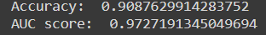
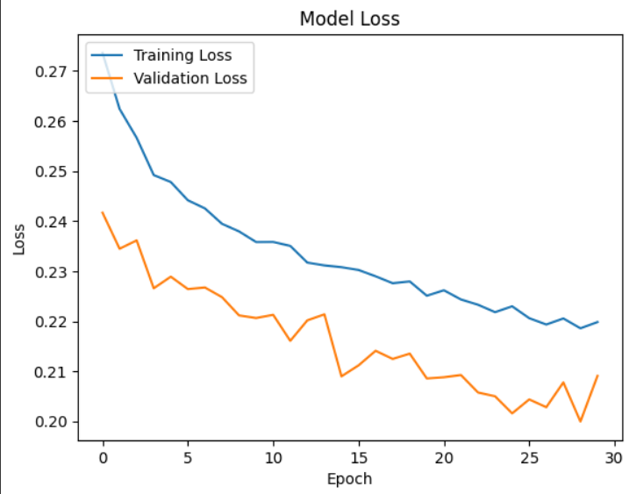
MODEL SELECTION
After training all the classifiers using the train data the best score was achieved by neural network model.
Accuracy of the neural network model was 87% and the graph shows the comparsion betweeen training loss and validation loss.

Slide 13
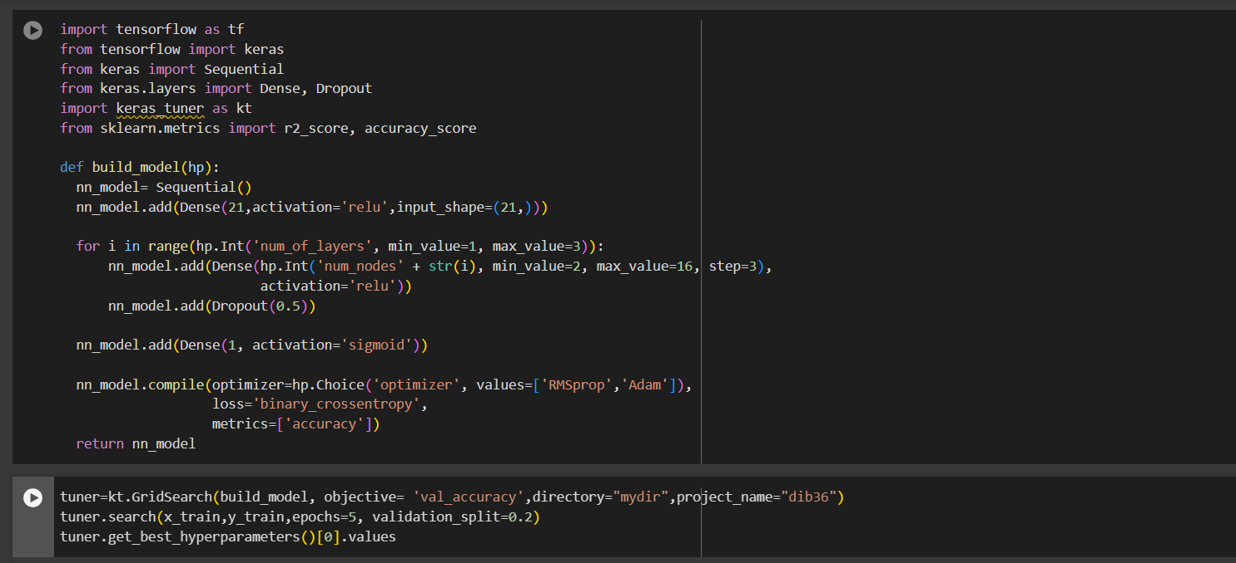
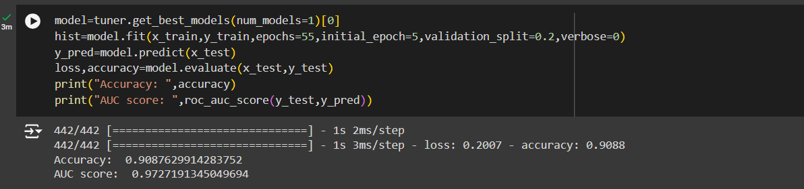
RESULT ANALYSIS
Predicting Profit using the selected model Model evaluation using AUC score

Slide 14

THANK YOU!

